Slide 1

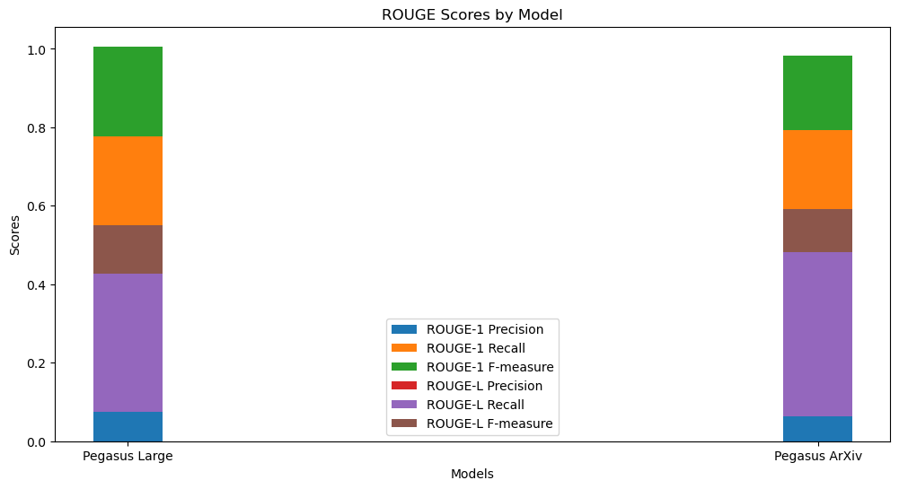
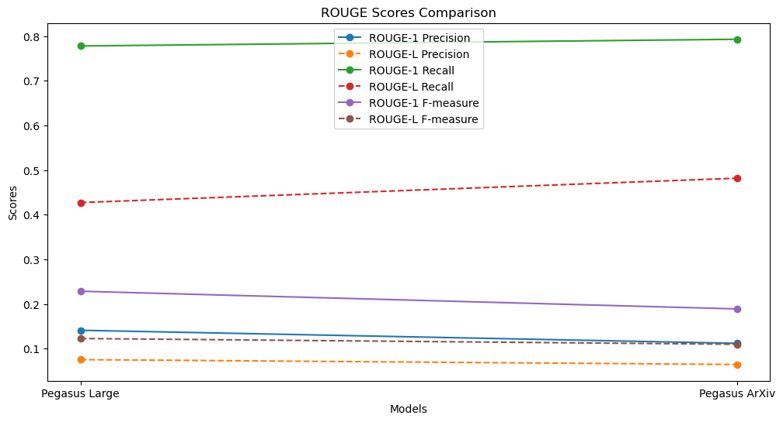
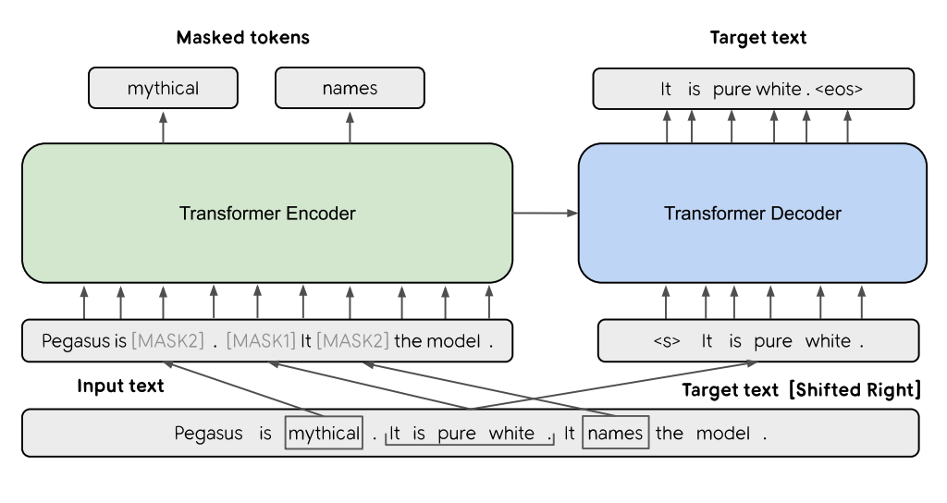
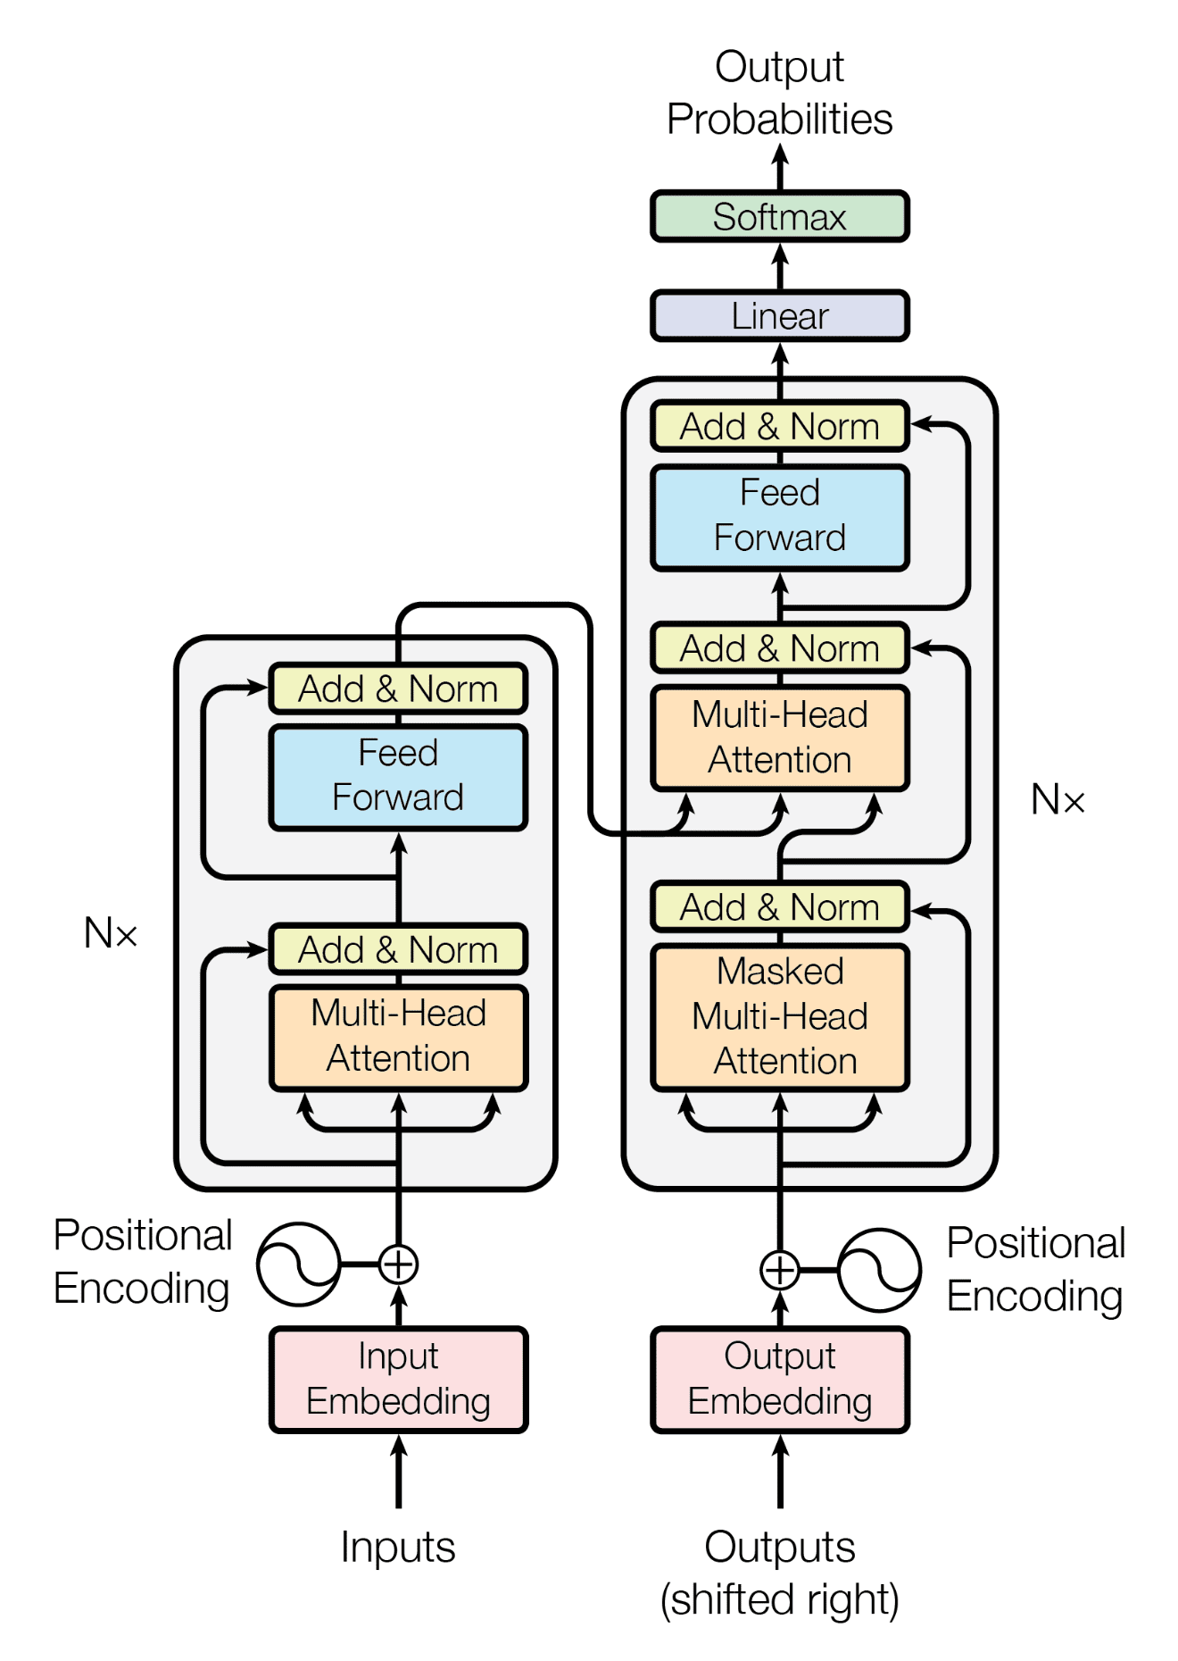
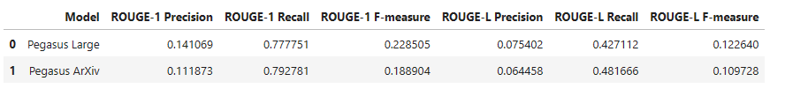
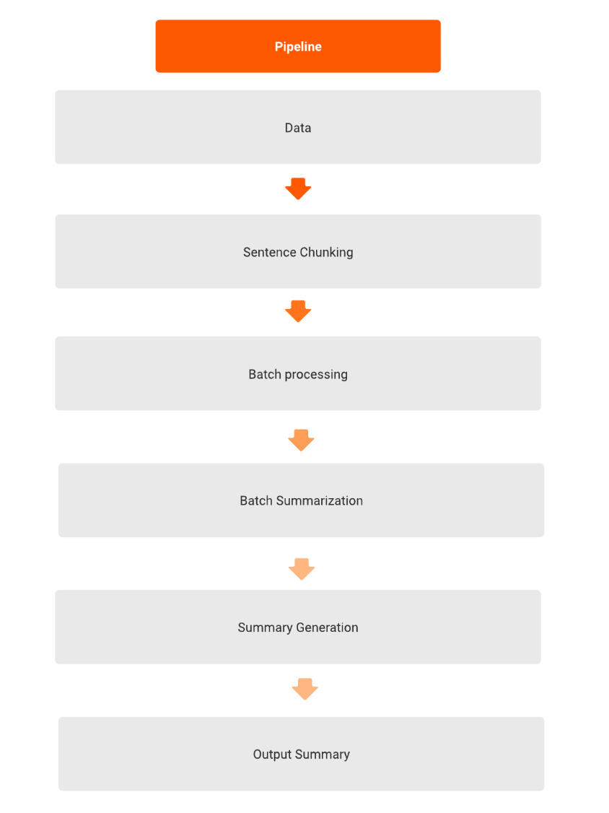
Automatic Abstractive Text Summarization for scientific papers using Pegasus Models and comparative analysis of different Pegasus variants
Department of Computer Science
By Ali Zamin
Problem
Producing a shorter version of long texts while preserving the salient information.
Text summarization helps in quickly understanding the essence of large documents, saving valuable time.
Two types of summarization: Extractive and Abstractive
Extractive: Select parts of the original text to form a summary
Easier
Restrictive (no paraphrasing)
Abstractive: Generate new text using Natural Language Generation techniques.
More Difficult
More Flexible (more human)
I used Abstractive method as it utilizes NLP techniques
Project Goals: Use different variants of Pegasus models from Hugging Face to build model pipeline for producing summaries of long text scientific documents, compare the performance between the base variant and the fine-tuned domain specific variant.
Model
Results
Pegasus model mechanism
Transformer Architecture
Pegasus model mechanism
Data + Processing
Utilized a dataset comprising of Arxiv’s scientific documents and their abstractions with over 1000 samples from Hugging Face.
Converted the JSON file to csv file to be able to use with our model
Tokenized all the text document’s sentences.
Grouped all the sentence tokens into chunks in order to handle the long text and pass it as a one token to the model so that the model has access to the full text.
Used batch processing to handle the data flow to the model.
Pipeline
Discussion and Takeaway
Both Pegasus variants turned out not to be as abstractive as it claims based on summary results.
Model needs fine tuning to handle the LaTex and mathametical notations.
Some data engineering is needed to handle all the special characters in the text.
References: FLAN-T5 Tutorial: Guide and Fine-Tuning | DataCamp
bakhitovd/ML_arxiv · Datasets at Hugging Face
google/pegasus-arxiv · Hugging Face
google/pegasus-large · Hugging Face
*Size of this logo is notably smaller than the primary Washington University logo in header.
Outside entity logo,
if needed*
Example 3: Funding provided by the American Physical Therapy Association’s xxxxxxxx Program.

Slide 2
Poster title here set in Source Sans Semibold 66 pt but can adjust size to fit the length of the title, use shorter titles if possible
Department, name in text here.
Example 2:
This work was conducted in partnership with the University of Southern California and the University of Minnesota/Minnesota Health.
OR Funding was provided in part by the Barnes-Jewish Hospital Foundation.
If less space is needed to refer to funding sources, a smaller area may be used for either Example 2 or 3.
If no other funding source is needed to refer to, this area can be deleted too.
Example 3: Funding provided by the American Physical Therapy Association’s xxxxxxxx Program.
*Size of this logo is notably smaller than the primary Washington University logo in header.
Outside entity logo,
if needed*

Slide 3
Poster title here use shorter titles if possible
Department, name in text here.
If less space is needed to refer to funding sources, a smaller area may be used for either Example 2 or 3.
If no other funding source is needed to refer to, this area can be deleted too.

Slide 4
Poster title here set in Source Sans Semibold 66 pt but can adjust size to fit the length of the title, use shorter titles if possible
Department, name in text here.
If less space is needed to refer to funding sources, a smaller area may be used for either Example 2 or 3.
If no other funding source is needed to refer to, this area can be deleted too.

